Slide 1
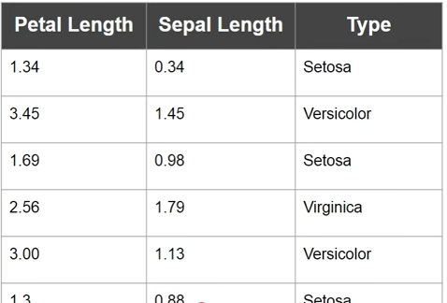
Decision Trees:
Decision Tree for numerical Data:

Slide 2
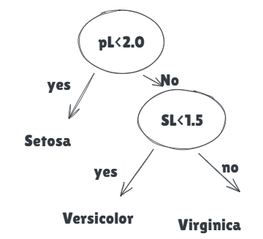
Decision Trees:
Decision Tree for numerical Data:

Slide 3
Decision Trees:
Decision Tree Disadvantages:
When building decision Tree at its complete depth then then decision tree is learning very well on the train data.
On the test data, the decision tree does not generalizes well (poor performance on the new test data).
This results in overfitting the model.
Overfitting
Decision trees can grow very deep
They memorize training data
High variance, low bias

Slide 4
Ensembles of Decision Trees:
A single decision tree overfits. Ensembles combine many Decision trees to get more accurate, stable, and generalizable models.
How ensembles fix Decision Tree problems
🔹 Reduce variance
Each tree makes different mistakes
Averaging predictions smooths errors
🔹 Improve generalization
Less sensitive to noise
Better performance on unseen data

Slide 5
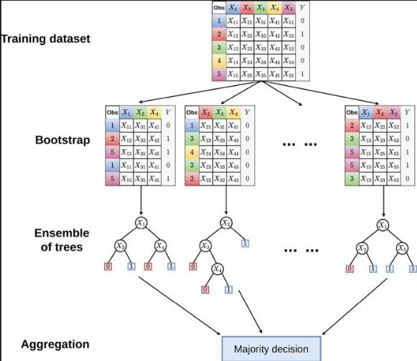
Ensembles of Decision Trees:
Random Forest Classifier : Bagging or Bootstrap Samples

Slide 6
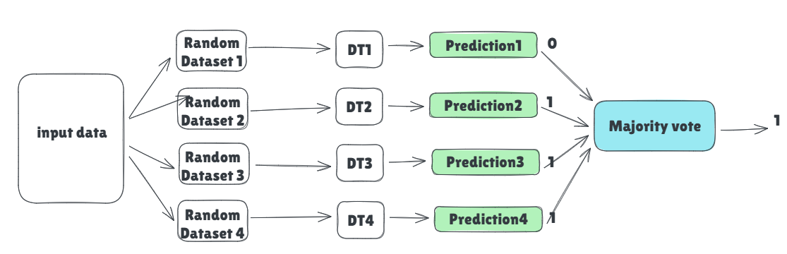
Ensembles of Decision Trees:
1. Random Forest Classifier:

Slide 7
Ensembles of Decision Trees:
1. Random Forest Classifier:
Probability-based voting (Actual behavior)
Each tree outputs class probabilities, not just labels.
Tree | P(class=0) | P(class=1)
Tree 1 | 0.20 | 0.80
Tree 2 | 0.40 | 0.60
Tree 3 | 0.70 | 0.30
Tree 4 | 0.55 | 0.45
Average probabilities
P(0)=(0.20+0.40+0.70+0.55)/4=0.4625
P(1)=(0.80+0.60+0.30+0.45)/4=0.5375
Final prediction = class 1

